Slide 1

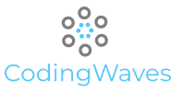
WELCOME!
Who we are and what we will do...

Slide 2
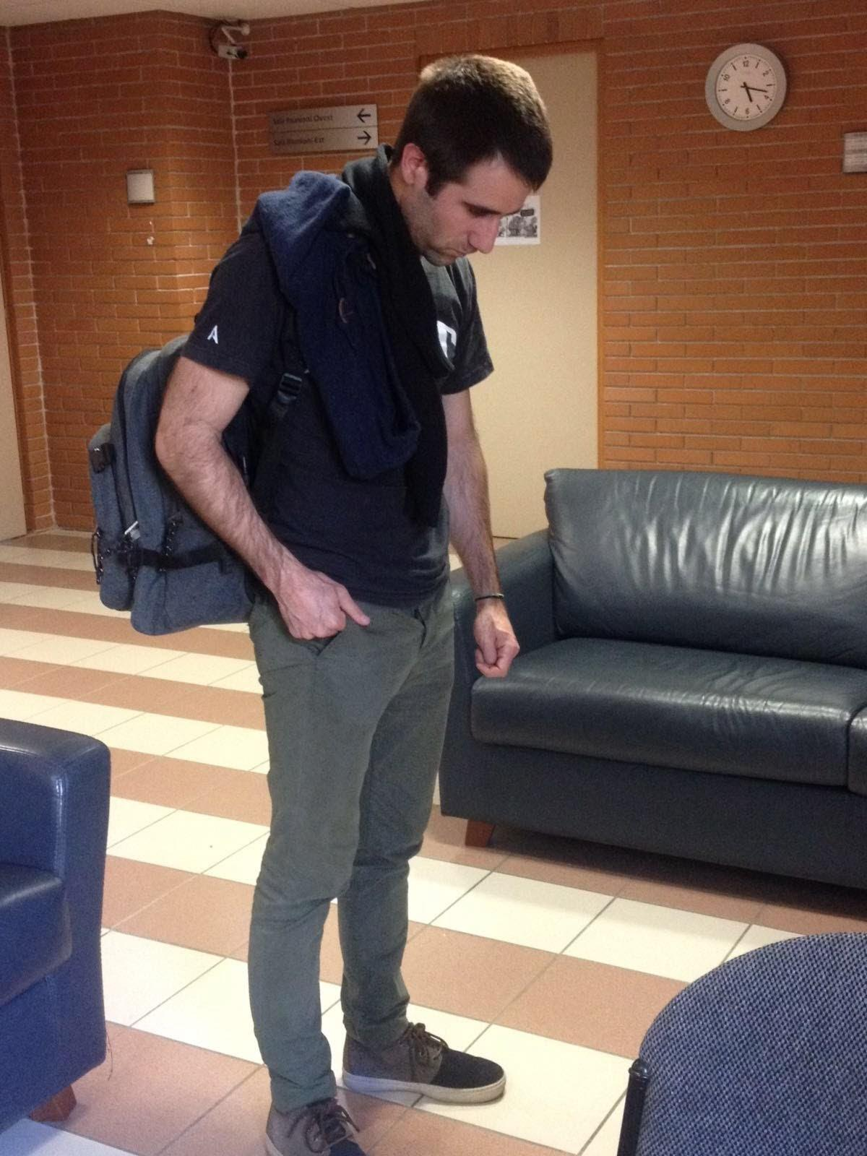

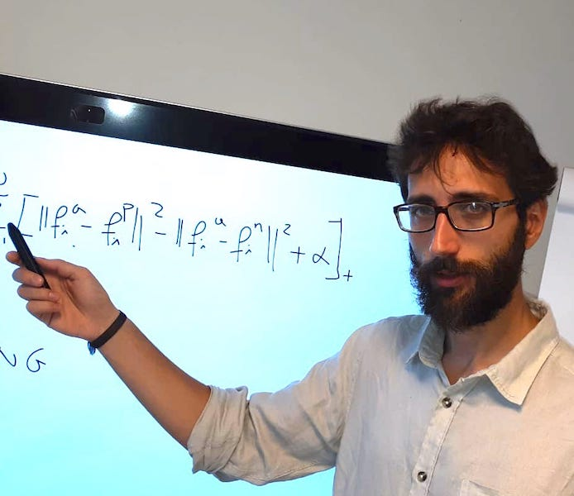
Who we are

Slide 3
Goal
The main goal of CodingWaves is:
Learn Python and Data Manipulation
Get the main blocks to orientate you in Data Science world.
Learn the basic concepts of Machine Learning so that you are able to “survive” a Junior Data Scientist Position interviews. In fact usually the technical part is limited but the “conceptual” part is more important.
Surf
Have fun!
Be in contact with our partners for future

Slide 4
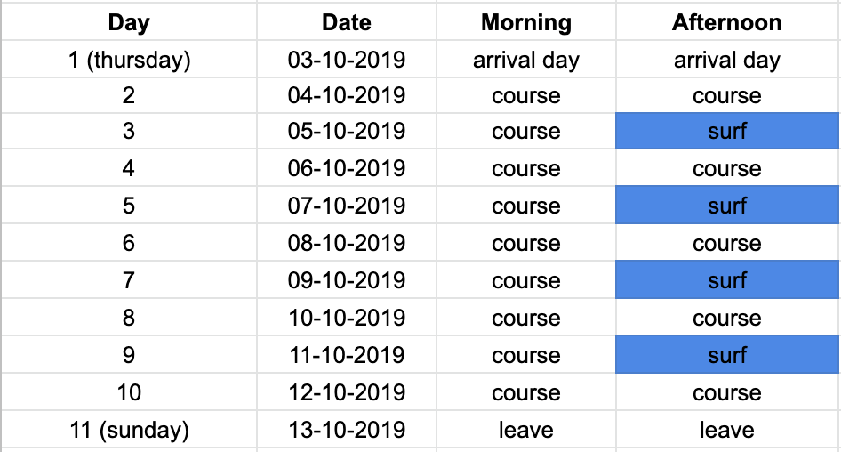
Surf Lessons and Schedule
The schedule could change based on waves conditions

Slide 5

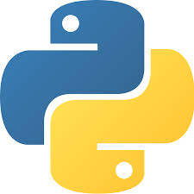
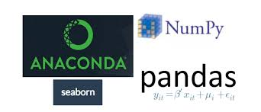

Main Course Blocks:
Intro to Python
Numpy, Pandas, Seaborn, Matplotlib
Intro to Machine Learning

Slide 6







Our Partners
UK and Italy
Head Hunters. Job Placement
Milan: Investment Fund
Milan: Data Science
Milan: Mobile Apps
Italy: Group
Barcelona: Scooters
WorldWide: Consultancy

Slide 7

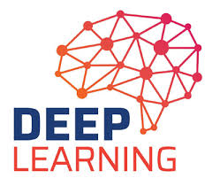
Evolution
Lisbon 2020

